Slide 1
Conference on Border Crossing in Greater China: Production, Community and Identity
Center for China Studies, National Chengchi University, Taipei
13-14 September 2012
Ethnic Identity of Hong Kong People:
An Academic Question turned Political
Robert Chung, Edward Tai
Public Opinion Programme
The University of Hong Kong

Slide 2
Ethnic Identity of Hong Kong People
Methodological Framework
  From dichotomy to one-in-four choices
  From one-in-four choices to strength ratings
  From strength ratings to “identity indices”
Describing the Trend of Ethnic Identities
  “Hongkongers” versus “Chinese”
  Strength rating for identities – “Hongkongers” vs “Chinese”
  “Identity indices” – Six identities gathered together
Ethnic Identity turned Political
What next?

Slide 3
Study of Ethnic Identity
Dichotomy of “Hongkonger”（香港人）versus “Chinese”（中國人）was widely used by Hong Kong sociologists in the 1980s
From a 1985 survey by Lau & Kuan “
  “59.5 percent of the respondents identifies themselves as Hongkongese, 36.2 percent as Chinese.”
  the proportion of those opting for a Hong Kong identity was “striking”
  people’s “sense of attachment to Hong Kong is tremendous”

Slide 4
Methodological Framework
From dichotomy to one-in-four choices
The traditional method: choose from a dichotomy of “Hongkonger” （香港人） vs “Chinese”（中國人）
But the concepts of “Hongkonger” and “Chinese” may overlap with each other
Instead of using “don’t know”, “hard to say” and other uncertain answers as the middle choice, two more specific answers were offered, namely, “Hongkonger in China”（中國的香港人）and “Chinese in Hong Kong”（香港的中國人）

Slide 5
Methodological Framework
From dichotomy to one-in-four choices
“Hongkonger in China” （中國的香港人）= “ethnically Hongkonger living in China”, meaning a stronger sense of the “Hongkonger” identityand “Chinese in Hong Kong”
“Chinese in Hong Kong” （香港的中國人） = “ethnically Chinese living in Hong Kong”, meaning a stronger sense of the “Chinese” identity
Managed to narrow down some ambivalent answers to more specific labels like “Hongkonger in China” and “Chinese in Hong Kong”

Slide 6
Methodological Framework
“Hongkonger in the broadest sense”（廣義香港人）
“Hongkonger”（香港人）
“Hongkonger in China”（中國的香港人）
“Chinese in the broadest sense”（廣義中國人）
“Chinese”
（中國人）
“Chinese in Hong Kong”（香港的中國人）

Slide 7
Methodological Framework
From one-in-four choices to strength ratings
There is a methodological blind spot regarding the absolute strength of identities when answering dichotomous or one-in-four choices
Two more rating questions added to rate respondents’ strength of their “Hongkongers” and “Chinese” identities separately using a 0-10 scale
In June 2007, the survey is further enhanced to include four more identities for strength rating, namely, “citizens of People’s Republic of China”, “members of the Chinese race”, “Asians” and “global citizens”, in order to depict a clearer picture of cultural and ethnic identities

Slide 8
Methodological Framework
From strength ratings to “identity indices”
Separate importance ratings for all different identities are added in December 2008
“Identity indices” computed by taking the geometric means of “strength” times “importance” then multiplied by 10
The importance ratings are introduced because some people may give a high rating on an identity, but do not feel that the identity has too much relevance in their political or social life

Slide 9
Methodological Framework
Identity Indices
Strength Ratings
Importance Ratings
X 10

Slide 10
Describing the Trend of Ethnic Identities

Slide 11
Describing the Trend of Ethnic Identities

Slide 12
Describing the Trend of Ethnic Identities

Slide 13
Describing the Trend of Ethnic Identities

Slide 14
Describing the Trend of Ethnic Identities

Slide 15
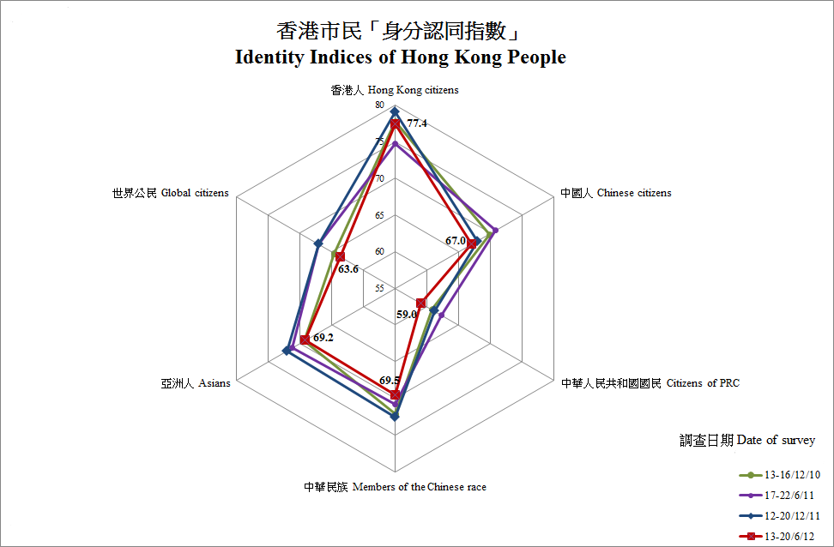
Describing the Trend of Ethnic Identities

Slide 16
Ethnic Identity turned Political
28 December 2011, the POP released its latest finding that “in terms of absolute rating, people’s identification with ‘Hongkonger’ has reached a ten-year high, while that of ‘Chinese’ has dropped to a 12-year low”
One day later, Hao Tiechuan, Director of the Publicity, Cultural and Sports Department of the Liaison Office of the Central People’s Government in Hong Kong openly criticizes the survey as “unscientific” and “illogical”, because it uses a dichotomous measurement of “Hongkongers” and “Chinese”, which is not mutually exclusive
Severe criticisms from leftist commentators followed

Slide 17
Ethnic Identity turned Political
All Cultural Revolution type rhetoric and accusations can be summarized into three lines of arguments:
  Because the survey requires people to choose between the identities of “Hongkongers” and “Chinese”, it is unscientific and illogical
  The survey conducted before Hong Kong’s handover was not of a problem, but when carried out after the handover, it becomes “unscientific”
  The survey advocates the independence of Hong Kong and thus has an ulterior motive
The criticism was seen by some analysts in Hong Kong as a prelude to leftist commentators’ attacks on the “3.23 Civil Referendum” Project proposed near the end of 2011, and scheduled to take place on 23 March 2012

Slide 18
Ethnic Identity turned Political
A six-point rebuttal:
Asking people to choose the most desired identities among four overlapped options, namely, “Hongkongers”, “Chinese Hong Kong citizen”, “Chinese” and “Hong Kong Chinese citizen” is not unreasonable, even though it may have problems of “subsumption and inclusion”
The results released come from two separate and independent questions, they are single-item questions which do not involve any “logical” problem
The “scientific nature” or “logical dimension” of a study is impossible to be changed with the political climate

Slide 19
Ethnic Identity turned Political
If the above survey methodology is “unscientific” in Hong Kong, then similar surveys on ethnic identity cannot be “scientific” elsewhere in the world
The study comprised of 13 opinion questions plus 9 demographics variables, the study is already very comprehensive and useful. Hao’s complete denial of the 22-question strong survey, straddling over 15 years, with one single question which he considers “illogical”, is just too arbitrary and dogmatic
The proposition that the author is splitting the country in the name of academic research, against all academic ethics and morals, is a direct discredit of the author’s research achievements; academic institutions should pay attention to this, and should even consider to provide appropriate legal protections for the innocent academics

Slide 20
What next?
Six months after the leftist commentators launched their attack, in June 2012, the Public Opinion Programme at the University of Hong Kong again releases its latest findings of the same survey
“People’s identification with ‘Hong Kong citizens’ has dropped back a bit compared to 6 months ago, but their identification with ‘Chinese citizens’ has dropped to a 13-year low since the end of 1999. Indepth analysis shows that the rating of those under 30 years of age continues to drop since mid-2009, and plunges to just over 5 points in the past 6 months. This warrants special attention…”
The release concurred with the 15th anniversary of the HKSAR. This time, the leftist commentators remain silent

Slide 21
THANK YOU !

