Slide 1
Conference on Trust-Building and Governance in Hong Kong and Macao
The Hong Kong Institute of Education
19-20 October 2012
Public Trust and Public Sentiment
Robert CHUNG
Director of Public Opinion Programme
The University of Hong Kong

Slide 2
Public Trust and Public Sentiment
Outline of Presentation
Public Trust
  Latest Findings: Press Release of 18 September 2012
  Time Series: 1992 – 2012 (21 years of data)
Public Sentiment
  Conceptual Framework of PSI
  PSI = GA‧SA
Public Trust and Public Sentiment
  Co-variation and Correlation
Conclusion

Slide 3
Findings released on 18 September 2012
Month of survey | 9/2011 | 12/2011 | 3/2012 | 6/2012 | 9/2012 | Latest Change
Total sample size | 1,038 | 1,005 | 1,022 | 1,003 | 1,036 | --
Overall response rate | 66.2% | 67.4% | 63.6% | 63.4% | 63.1% | --
Finding | Finding | Finding | Finding | Finding | Finding & error | --
Trust in HKSAR Government | 44%^{[10]} | 35%^{[10]} | 36% | 35% | 34+/-4% | -1%
Distrust in HKSAR Government | 28% | 32% | 36% | 32% | 35+/-4% | +3%
Net trust | 16% | 3% | -- | 3% | -1+/-7% | -4%
Mean value | 3.2+/-0.1 (Base=487) | 3.0+/-0.1 (Base=529) | 2.9+/-0.1 (Base=580) | 3.0+/-0.1 (Base=537) | 2.9+/-0.1 (Base=543) | -0.1
Trust in Beijing Government | 35% | 33% | 39%^{[10]} | 32%^{[10]} | 26+/-4% | -6%
Distrust in Beijing Government | 33% | 32% | 34% | 37% | 40+/-4% | +3%
Net trust | 2% | 1% | 5% | -5% | -14+/-7% | -9%
Mean value | 3.0+/-0.1 (Base=552) | 3.0+/-0.1 (Base=527) | 3.0+/-0.1 (Base=529) | 2.8+/-0.1 (Base=515) | 2.7+/-0.1 (Base=536) | -0.1
3

Slide 4
Commentary released on 18 September 2012
Robert Chung’s comments
Our latest survey shows that all trust and confidence indicators have dropped. People's trust in the HKSAR Government drops to a new low since April 2004, their trust in the Central Government drops to a new low since June 2000, giving a net trust value of negative 14 percentage points, and a new high in their distrust level since May 1997. People's confidence in the future of Hong Kong and China, although having net values of positive 12 and 42 percentage points, are at new lows since August 2003 and January 1998 in terms of positive confidence. People's trust in the Taiwan Government has also dropped, but only to a new low since December 2011, with a net trust value of negative 4 percentage points. The legislative election, dispute over national education, and the incidents of Li Wangyang and Diaoyu Islands, may all have contributed to these changing figures.
4

Slide 5
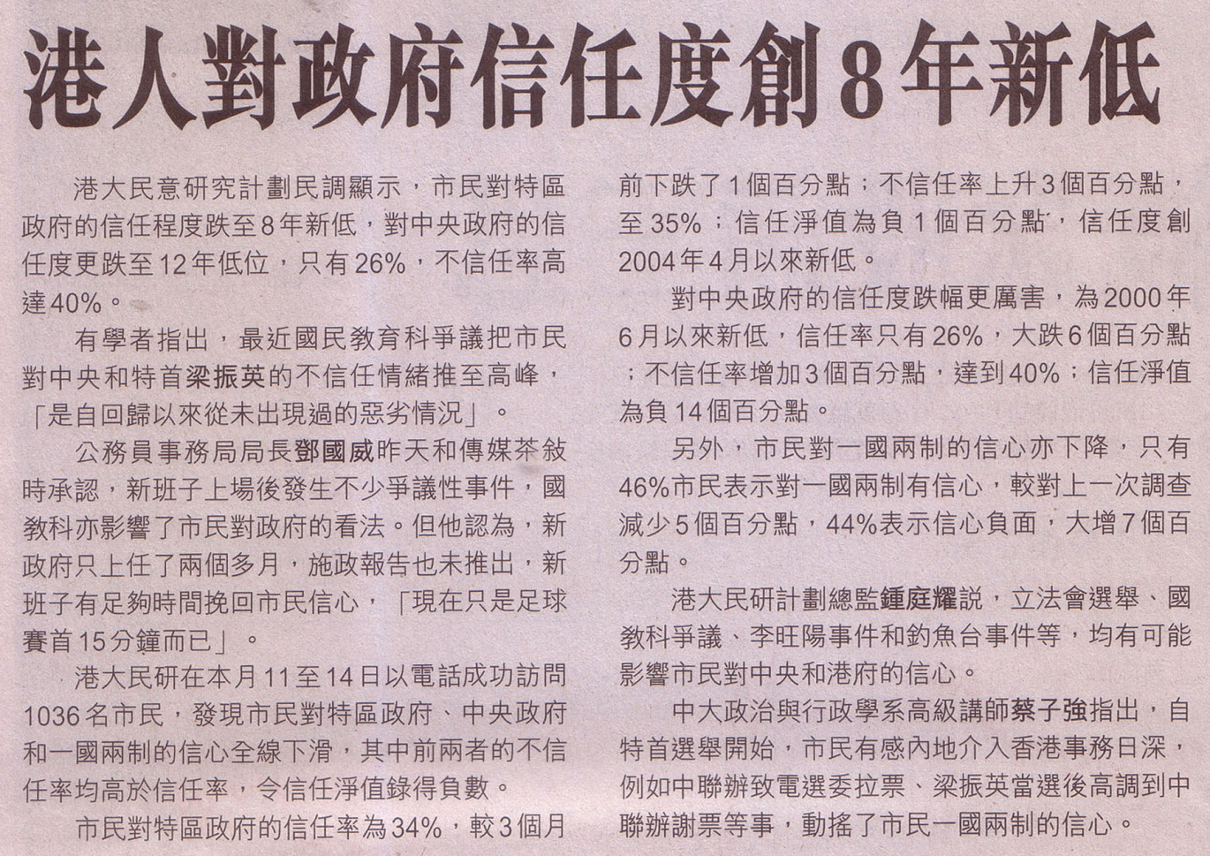
Selected News Clippings
Hong Kong Economic Journal 信報
5

Slide 6
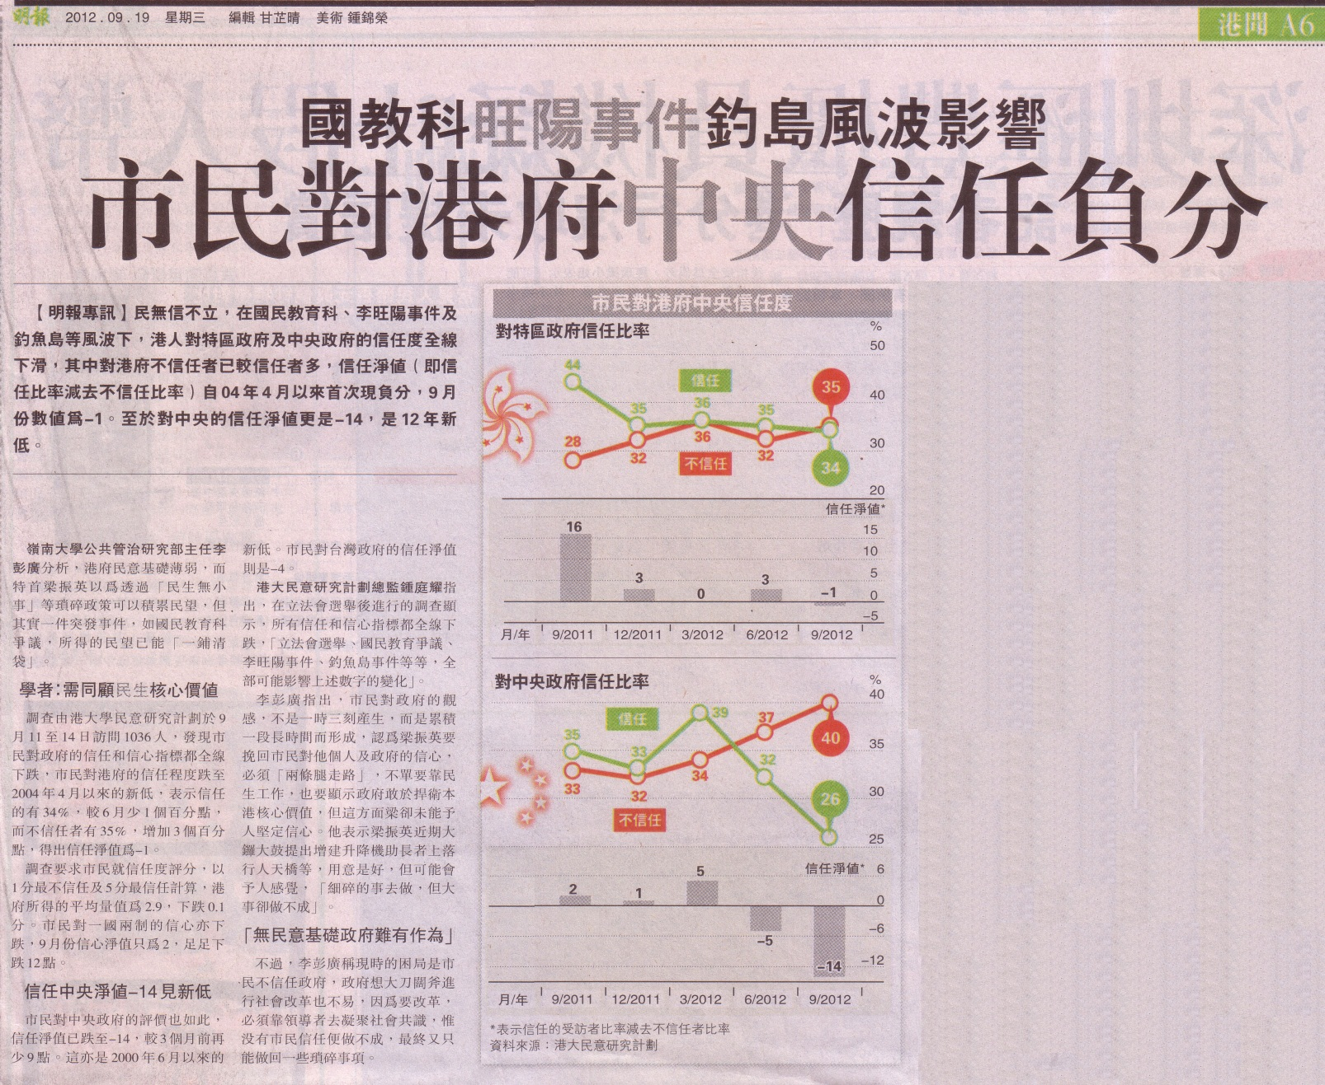
Selected News Clippings
Ming Pao 明報
6

Slide 7
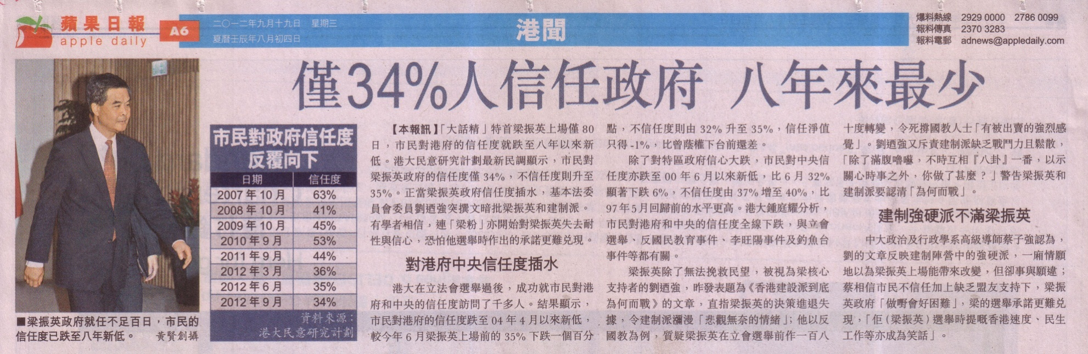
Selected News Clippings
Apple Daily 蘋果日報
7

Slide 8
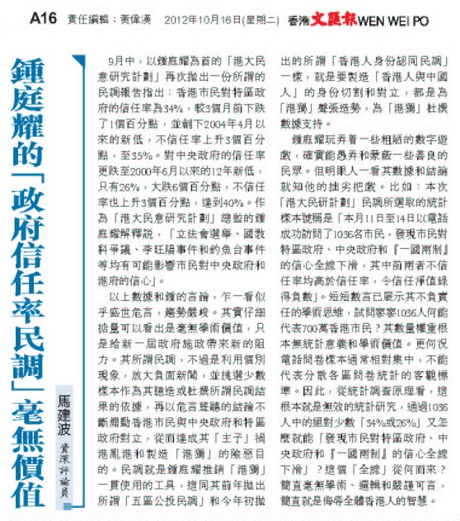
Selected News Clipping
試問寥寥1036人何能代表700萬香港市民？其數量權重根本無統計意義和學術價值…… 簡直毫無學術、邏輯和嚴謹可言，簡直就是侮辱全體香港人的智慧。
←
8

Slide 9
Some Details of the Survey
Question wording | Answer options
On the whole, do you trust the Hong Kong Government (before July 1997) / HKSAR Government (after July 1997)? (Interviewers probe extent) 整體黎講，你信唔信任香港特區政府？ 〔訪問員追問程度〕 | Trust very much 非常信任 Trust somewhat 幾信任 Half half 一半半 Distrust somewhat 幾不信任 Distrust very much 非常不信任 Don't know / hard to say 唔知/難講
On the whole, do you trust the Beijing Central Government? (Interviewer to probe extent) 整體黎講，你信唔信任北京中央政府呢？〔訪問員追問程度〕 | Trust very much 非常信任 Trust somewhat 幾信任 Half half 一半半 Distrust somewhat 幾不信任 Distrust very much 非常不信任 Don't know / hard to say 唔知/難講
9
Notes:
9

Slide 10
People’s Trust in HKG/HKSARG
10

Slide 11
People’s Trust in the Beijing Central Government
11

Slide 12
Public Sentiment Index (PSI)
Objectives
To quantify the general feeling of Hong Kong people towards the socio-political condition of Hong Kong
To explain or predict the likelihood of collective behaviour, social movement, social disorder and/or governance crisis
PSI sub-indices
Two sub-indices have been constructed: government appraisal (GA) and society appraisal (SA)
12

Slide 13
Conceptual Framework of PSI
Government Appraisal Sub-index (GA) | Earliest Data point | Data Frequency
(1) CE Rating | Dec 1992 | Twice a month
(2) CE Approval rate | Feb 2002 | Twice a month
(3) Government Satisfaction | Jul 1997 | Once a month
(4) Trust in Government | Dec 1992 | Once a quarter
13
Notes:
13

Slide 14
Conceptual Framework of PSI
Government Appraisal (GA) | Data | Question wordings
(1) CE Rating | 0 to 100 marks | Please use a scale of 0-100 to rate your extent of support to the Chief Executive Donald Tsang Yam-kuen, with 0 indicating absolutely not supportive, 100 indicating absolutely supportive and 50 indicating half-half. How would you rate the Chief Executive Donald Tsang Yam-kuen?
(2) Net CE Approval rate | -100% to +100% | If a general election of the Chief Executive were to be held tomorrow, and you had the right to vote, would you vote for Donald Tsang Yam-kuen?
(3) Mean value Government Satisfaction | 1 to 5 marks | Are you satisfied with the overall performance of the HKSAR Government? (Interviewer to probe extent)
(4) Mean value Trust in Govt. | 1 to 5 marks | On the whole, do you trust the Hong Kong Government (before 1-7-97) / HKSAR Government (after 1-7-97)? (Interviewer to probe extent)
14
Notes:
14

Slide 15
Conceptual Framework of PSI
Society Appraisal Sub-index (SA) | Earliest Data point | Data Frequency
(1) Political condition | Dec 1992 | Once half a year
(2) Economical condition | Dec 1992 | Once half a year
(3) Social condition | Dec 1992 | Once half a year
(4) Weights of importance | Dec 1992 | Once half a year
15
Notes:
15

Slide 16
Conceptual Framework of PSI
Society Appraisal (SA) | Data | Question wordings
Political condition Mean value | 0 to 10 marks | Generally speaking, are you satisfied with the present political condition in Hong Kong? (Interviewer to probe extent)
(2) Economical condition Mean value | 0 to 10 marks | Generally speaking, are you satisfied with the present economic condition in Hong Kong? (Interviewer to probe extent)
(3) Social condition Mean value | 0 to 10 marks | Generally speaking, are you satisfied with the present social condition in Hong Kong? (Interviewer to probe extent)
(4) Ratio of importance ratings of (1), (2), (3) per individuals | 0 to 1 | Weightings calculated from the ratios of the mean value of the 3 conditions per individual respondent
16
Notes:
16

Slide 17
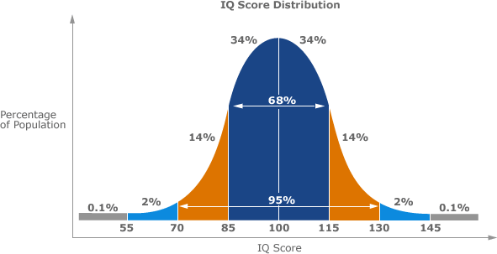
Conceptual Framework of PSI
17
Notes:
17

Slide 18
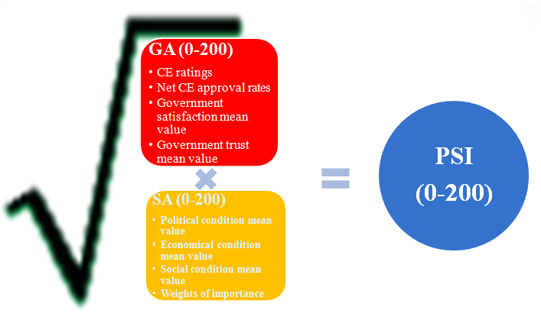
Conceptual Framework of PSI
18
Notes:
18

Slide 19
Conceptual Framework of PSI
Score value | Percentile | Score value | Percentile
140 – 200 | Highest 1% | 0-60 | Lowest 1%
125 | Highest 5% | 75 | Lowest 5%
120 | Highest 10% | 80 | Lowest 10%
110 | Highest 25% | 90 | Lowest 25%
100 being normal level, meaning half above half below
19
Notes:
19

Slide 20
Chart on Public Sentiment Index
20
Notes:
20

Slide 21
PSI, GA, SA
21
Notes:
21

Slide 22
PSI, GA, SA
Time | GA | SA | PSI
Dec1992 (PSI starts) | 100.8 | 110.5 | 107.3
Feb 1994 (political reform plans by Chris Patten) | 92.5 | 109.1 | 100.5
Apr 2003 (SARS) | 69.9 | 79.5 | 66.1
Jul 2003 (Massive demonstration) | 66.2 | 77.0 | 61.8
Jun 2005 (New CE come to office) | 123.5 | 102.6 | 116.6
Oct 2008 (Financial Tsunami) | 97.8 | 98.5 | 97.4
Jul 2012 (New CE come to office) | 91.9 | 92.6 | 88.5
Sep 2012 | 82.5 | 84.0 | 76.4
22
Notes:
22

Slide 23
Public Trust and Public Sentiment
23
Notes:
23

Slide 24
Public Trust and Public Sentiment
Correlation of Public Trust and Public Sentiment
People’s Trust to HKSAR Government vs Public Sentiment (PSI): 0.923 (0.973 after handover)
People’s Trust to Beijing Central Government vs Public Sentiment (PSI): 0.202
The high correlation of HKSARG Trust indicates a strong association with public sentiment, more trust, more positive sentiment.
The low correlation of Beijing Central Government Trust indicates a lower association with HK people’s sentiment.
24

Slide 25
Conclusion
Public trust in the local government is an important component of the general public sentiment, affecting the governability of Hong Kong society.
The construction of the Public Sentiment Index (PSI) with its government and society appraisal components should be able to provide deeper analysis of trust and governance down to incident and demographic levels.
Please click on http://hkupop.hku.hk → POP Resources → Public Opinion Lectures and Workshops → [weblink of today’s HKIEd conference] using account and password “hkied2012”.
25

